Slide 1
DATA ANALYTIC PROJECT
Product and Category Analysis for Retail Data
Neelima Joshi

Slide 2
Overview: Analyze product data to provide insights into product pricing, reviews, and stock management.
Goal: Improve business operations and customer satisfaction.
Dataset: A retail company's product catalog with attributes like price, stock, reviews, supplier, and return policy.

Slide 3
Data Overview & Key Attributes
Dataset Overview:
Records: 5,000
Columns: 15
Categories: 3 unique product categories
Warehouses: 3 unique warehouses
Duplicates: None based on Product ID
Missing Values: None in any column
Key Attributes Tracked: Price, Stock, Reviews, Supplier, Return policy

Slide 4
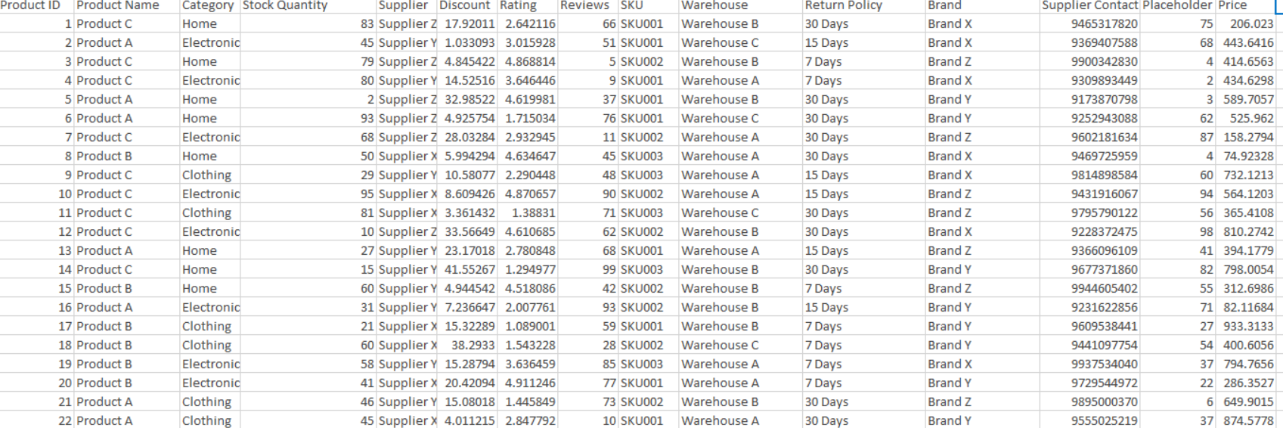
Data Layout

Slide 5
Key SQL Insights (Examples)
1. Premium Products per Category:
Several products are priced above their category average – ideal for premium targeting.
2. Top-Rated Categories:
Home category has the highest average product rating.
3. Most Reviewed Products by Warehouse:
Several popular products get many reviews and should be restocked quickly and used in offers or combos to boost sales.”

Slide 6
Key SQL Insights (Examples)
4. High-Value Products with Discount:
Several high-priced products are being offered with notable discounts, especially in Electronics. This presents a chance to drive sales volumes without hurting profit margins — if timed with events or holidays.
5. Top 2 Rated Products in Each Category:
The top two rated products in each category represent “hero products”. These can be highlighted in product listings, featured in ads, or used to benchmark quality for sourcing new products.
6. Return Policy Insights:
Products with a 30-day return policy had the highest stock, revenue, and ratings — indicating that flexible return policies build customer confidence and drive both satisfaction and sales.

Slide 7
Key Visual Insights (Tableau)
1. Revenue vs. Stock
Insight:
Electronics generates the high revenue despite having lower stock compared to other categories — indicating strong demand and fast turnover.
2. Price vs. Rating
Insight:
There is no strong correlation between price and rating — indicating that customer satisfaction is not dependent on price.
3. Products with 30-Day Return Policy per Warehouse
Insight:
Warehouse B stocks the highest number of products with a 30-day return policy — potentially offering better flexibility for customers in that region.

Slide 8
Key Visual Insights(Tableau)
4. Rating vs. Review Count
Insight:
Few low-rated products with high review counts reflect strong engagement but poor customer satisfaction. Highly rated products mostly fall in the moderate review count range
5. Warehouse-wise Product Turnover
Insight:
Warehouse C has the highest product turnover, indicating the most active sales channel. This could require faster inventory replenishment strategies.
6. Return Policy vs. Warehouse – Revenue Matrix
Insight:
7-Day return products generate the most revenue across warehouse C and then 30- Day return products again in warehouse C indicating flexible return options driving customer purchases.

Slide 9
Recommendations & Next Steps
Business Operations:
Optimize stock levels for high-revenue, low-stock categories to prevent lost sales.
Review pricing strategies for high-priced, low-rated products.
Promote top- rated products with fewer reviews.
Customer Satisfaction:
Leverage insights from highly-rated and reviewed products for cross-promotion or product improvement.
Address issues for products with many reviews but low ratings.

Slide 10
"THANK YOU !!!!"
“Any Questions?"

